Slide 1
Canadian Bioinformatics Workshops
www.bioinformatics.ca

Slide 2
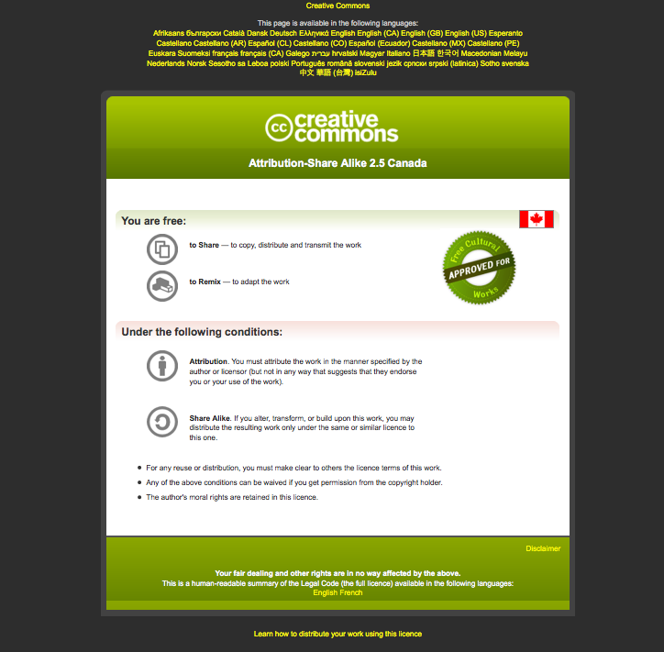
Module #: Title of Module
2

Slide 3
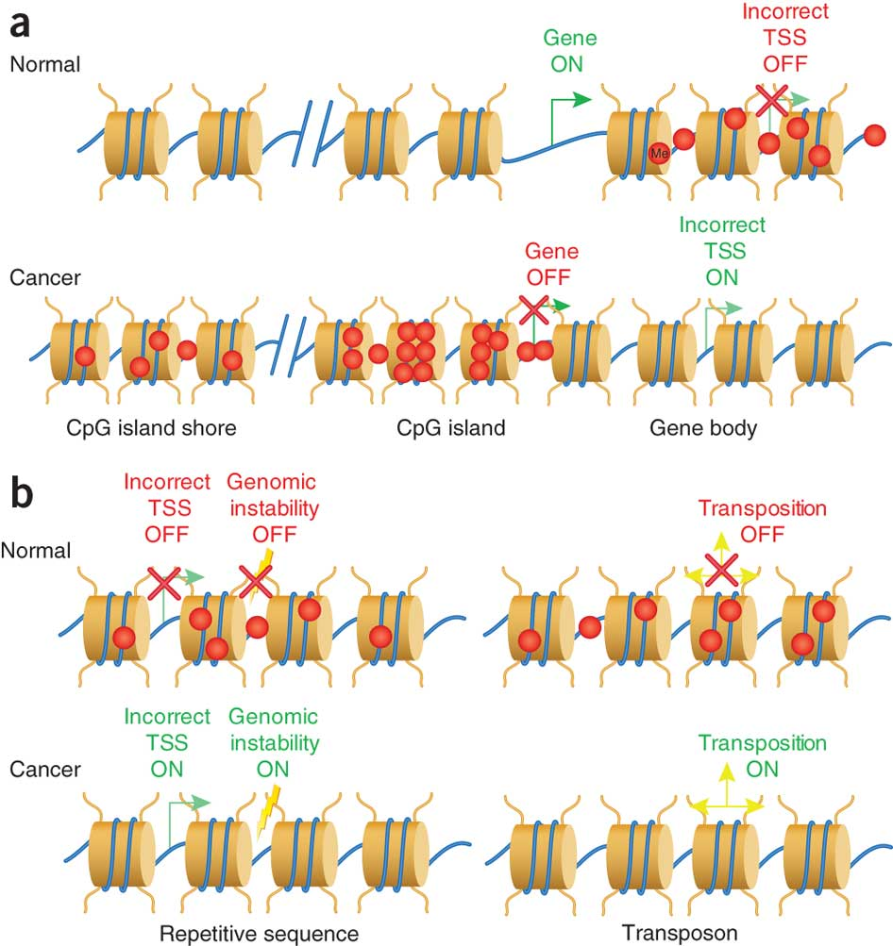


Module 3 Introduction to WGBS and analysis
Guillaume Bourque
Epigenomic Data Analysis
June 18-19, 2018

Slide 4
Learning Objectives of Module
Know the different technologies used to measure DNA methylation
Understand their strengths and weaknesses
Be familiar with the bisulfite-sequencing (BS-seq) data analysis workflow
Understand the underlying principles and challenges
Be able to extract methylation levels from BS-seq data
Know how to visualize BS-seq data
Be able to identify differentially methylated regions (DMRs)

Slide 5
What is DNA methylation?
Most common form of DNA methylation is 5-methylcytosine (5mC)
Affects 70 to 80% of CpGs in the human genome
High levels of 5-methylcytosine (5mC) in CpG-rich promoters is strongly associated with repression
In CpG poor regions, the relationship between DNA methylation and transcription is more complex
Bock, Nat Rev Genet, 2012

Slide 6
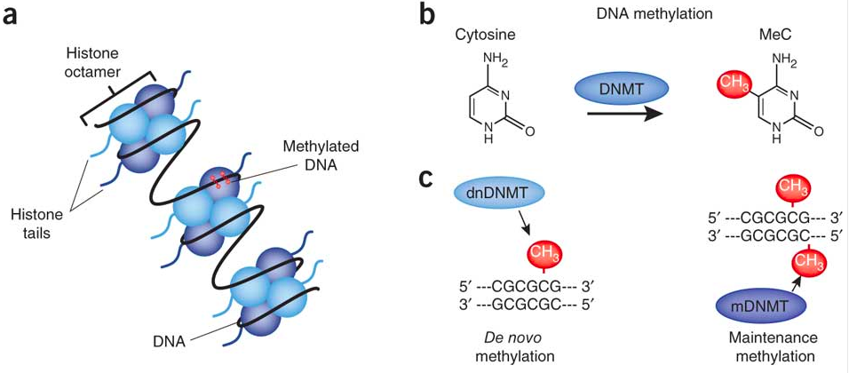
What is DNA methylation?
Day and Sweatt, Nat Neuro, 2010

Slide 7
Why study methylation?
Methylation is the only epigenetic mark with demonstrated mitotic inheritance
DNA methylation has been shown to be important for:
Genomic imprinting
Transposable element silencing
Stem cell differentiation
Embryonic development
Inflammation
Bock, Nat Rev Genet, 2012

Slide 8
Abnormal methylation in Cancer
Rodríguez-Paredes
& Esteller
Nat Med, 2011

Slide 9
Assays for measuring DNA methylation
Bisulphite microarrays: bisulphite mutations are mapped using genotyping microarrays that cover a selection of Cs
Enrichment-based methods: methylated (alternatively unmethylated) DNA fragments are enriched and then measured using NGS
Whole-genome bisulphite sequencing (WGBS): bisulphite mutations are mapped using NGS across de whole-genome

Slide 10
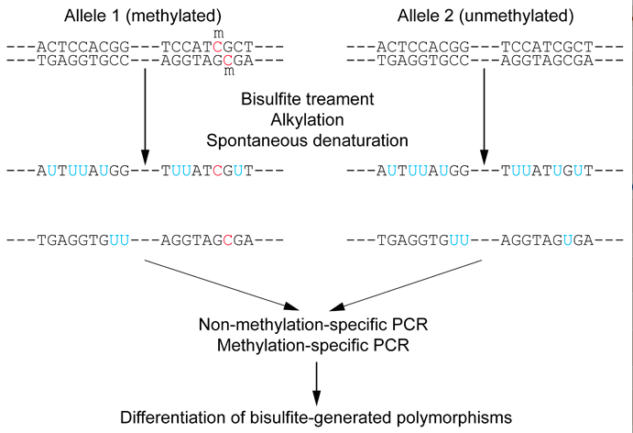
Bisulphite treatment
wikipedia.org

Slide 11
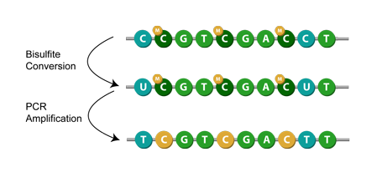
Bisulphite treatment (II)
www.epigentek.com

Slide 12
Bisulphite microarrays
DNA preparation
Bisulfite conversion
Hybridization onto microarray (e.g. Illumina 450K, MethylationEPIC (850K))
Data normalization and analysis

Slide 13
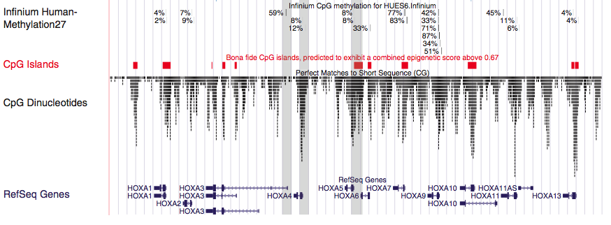
Methylation profile with microarray
Bock et al., Nat Biotech, 2010

Slide 14
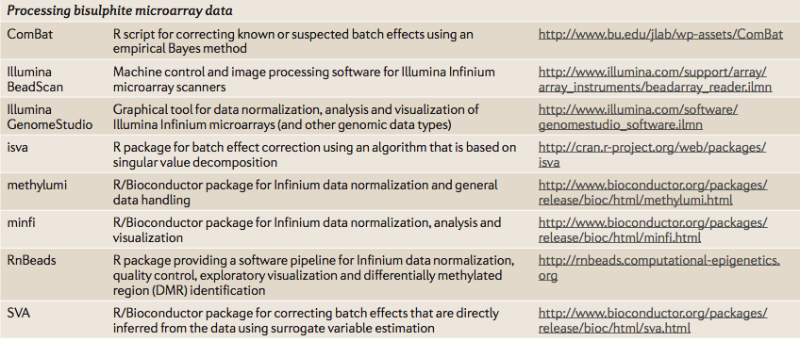
Processing bisulphite microarray data
Bock, Nat Rev Genet, 2012

Slide 15
Enrichment-based: MeDIP-seq
Sonification of DNA
Library preparation
Denaturation
Enrichment with antibody for 5-methylcytosine
Library amplification
High-throughput sequencing

Slide 16
Enrichment-based: MethylCap
Sonification of DNA
Enrichment with methyl-binding domain protein (the MBD domain of MeCP2)
Washing and elution
Library preparation and amplification
High-throughput sequencing

Slide 17
Enrichment-based: RRBS
Digestion with the MspI restriction enzyme
Library preparation
Gel-based size selection
Bisulfite treatment
Library amplification
High-throughput sequencing

Slide 18
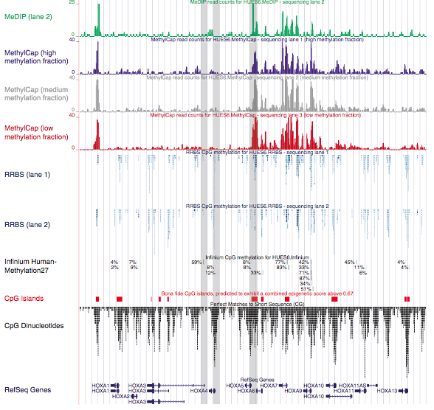
Enrichment-based methylation profiles
Bock et al., Nat Biotech, 2010

Slide 19
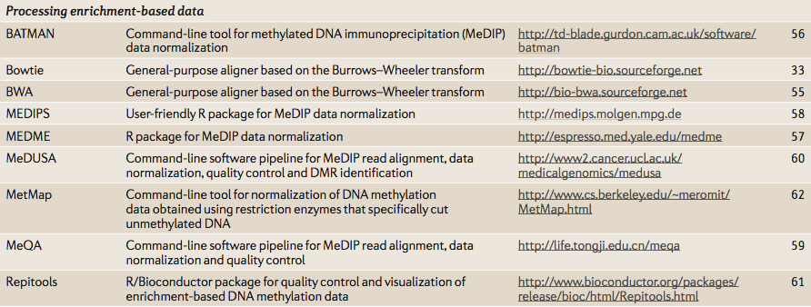
Processing enrichment-based data
Bock, Nat Rev Genet, 2012

Slide 20
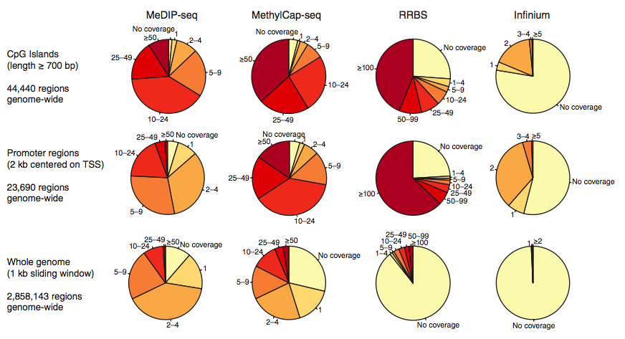
Differences in coverage
Bock et al., Nat Biotech, 2010

Slide 21
WGBS
Genomic DNA Isolation
Bisulfite treatment
Library preparation
High-throughput sequencing ($$$)

Slide 22
Enrichment-based: MCC-Seq
Genomic DNA Isolation
Library preparation
Bisulfite treatment
Capture of targeted DNA-fragments
High-throughput sequencing
Allum et al. Nat Comm, 2015

Slide 23
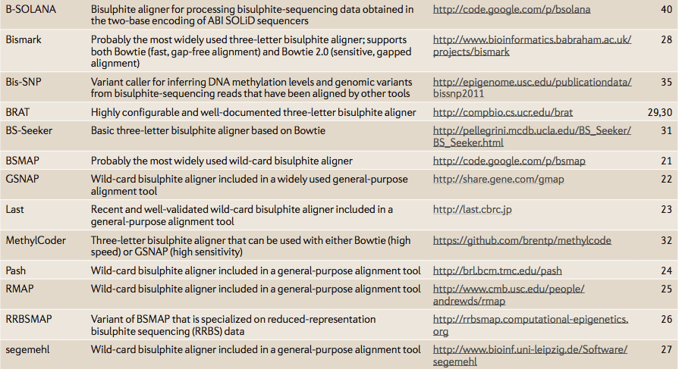
Tools for processing WGBS (and other BS-seq)
Bock, Nat Rev Genet, 2012
GEMBS
https://www.biorxiv.org/content/early/2017/10/11/201988

Slide 24
Microarray/enrichment-based/WGBS
All provide accurate DNA methylation measurements
Microarrays typically have lower-costs and provide accurate measurements across a large number of CpGs targeting important regions (promoters, CpG islands)
Enrichment-based methods (e.g. MeDIP-seq, MethylCap) have relatively low-resolution and can be a challenge to analyze/normalize
Bisulfite-based methods (e.g. RRBS, MCC-Seq and WGBS) provide absolute DNA measurements at a based-pair resolution
WGBS remains expensive

Slide 25
Workflow for analyzing BS-data
Processing of bisulfite-sequencing data:
Quality control and pre-processing
Bisulfite sequence alignment
Quantification of absolute DNA methylation
Data visualization and statistical analysis
Visual inspection in a genome browser of selected regions
Visualization of global distribution of methylation values
Clustering of samples based on similarity
Downstream analysis
Identification of Differentially Methylated Regions (DMRs)
Global analysis of DMRs

Slide 26
Workflow for analyzing BS-data
Processing of bisulfite-sequencing data:
Quality control and pre-processing
Bisulfite sequence alignment
Quantification of absolute DNA methylation
Data visualization and statistical analysis
Visual inspection in a genome browser of selected regions
Visualization of global distribution of methylation values
Clustering of samples based on similarity
Downstream analysis
Identification of Differentially Methylated Regions (DMRs)
Global analysis of DMRs

Slide 27
Importance of quality control
Before you start an analysis, it’s very important to look at your raw data!
Are all of your samples sequenced using the same protocol and instruments?
Are there any technical issues affecting some of the samples?
This is especially important if you plan to compare different samples or different conditions

Slide 28
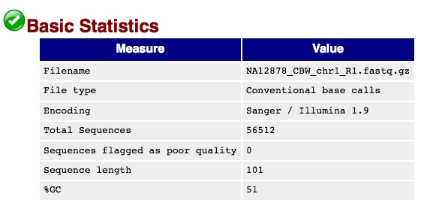
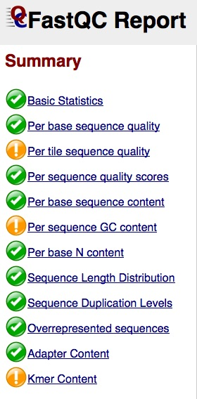
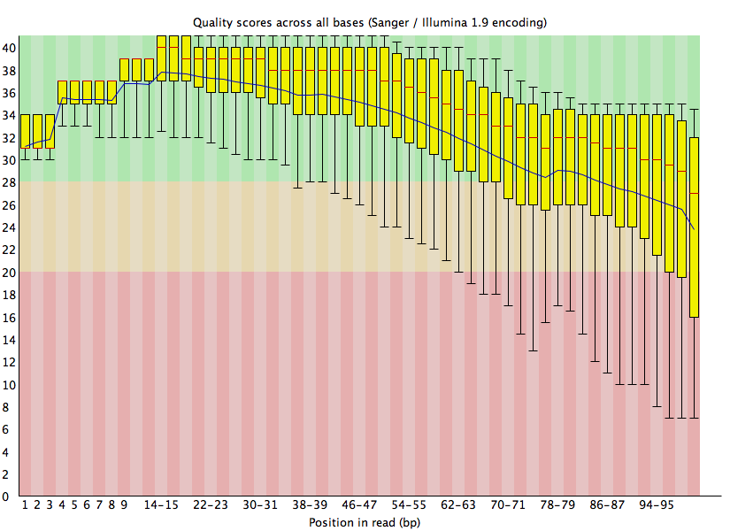
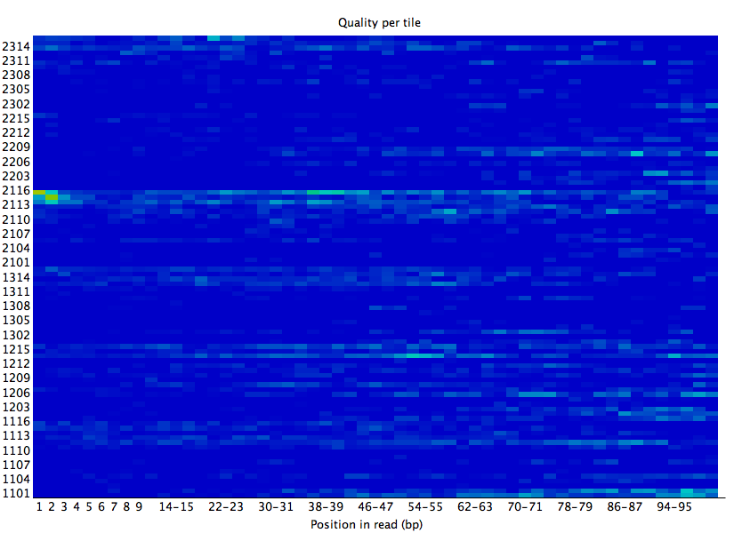
Running FastQC on read 1
Very good!

Slide 29
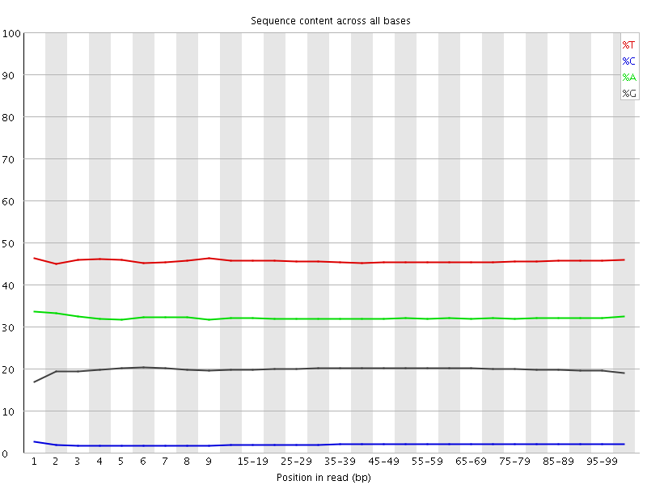
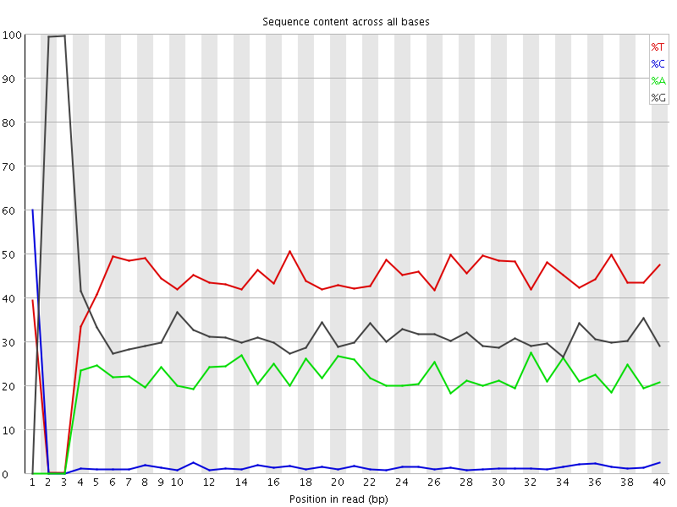
QC: Base Composition
WGBS
RRBS
Felix Krueger, Babraham Bioinformatics

Slide 30
Read trimming
Simple trimming: The method scans from the 5’ end of each read. As soon as it detects a position with quality scores below a preset threshold, it discards this position and the remaining positions at the 3’ end of the read.
Dynamic trimming (window based): The method searches for the longest stretch of positions (window) in each read such that the quality scores of each position in the window exceed a preset threshold.
Mott trimming (running sum): The method starts from the 3’ end of each read, subtracts a preset cutoff quality score from the quality score at each position and adds the remainder to a cumulative score at the position. The 3’ portion of the read starting from the position with the minimum cumulative score is trimmed.

Slide 31
Removing poor quality basecalls
Felix Krueger, Babraham Bioinformatics

Slide 32
Sequence duplication
Complex/diverse library:
Duplicated library:
percent methylation
55
17
100
100
71
100
100
deduplication
percent methylation
33
50
100
100
50
100
100
Felix Krueger, Babraham Bioinformatics

Slide 33
Quality metrics
Read quality
Presence of adapter sequencers
Duplicate rates
Conversion rate

Slide 34
ENCODE WGBS Standards
Experiments should have two or more biological replicates; they may have two technical replicates per biological replicate.
The C to T conversion rate should be ≥98%
The CpG quantification should have a Pearson correlation of ≥0.8 for sites with ≥10X coverage.
Sequencing may be paired- or single-ended, as long as sequencing type is specified and paired sequences are indicated.
The experiment must pass routine metadata audits in order to be released.
https://www.encodeproject.org/wgbs/

Slide 35
Workflow for analyzing BS-data
Processing of bisulfite-sequencing data:
Quality control and pre-processing
Bisulfite sequence alignment
Quantification of absolute DNA methylation
Data visualization and statistical analysis
Visual inspection in a genome browser of selected regions
Visualization of global distribution of methylation values
Clustering of samples based on similarity
Downstream analysis
Identification of Differentially Methylated Regions (DMRs)
Global analysis of DMRs

Slide 36
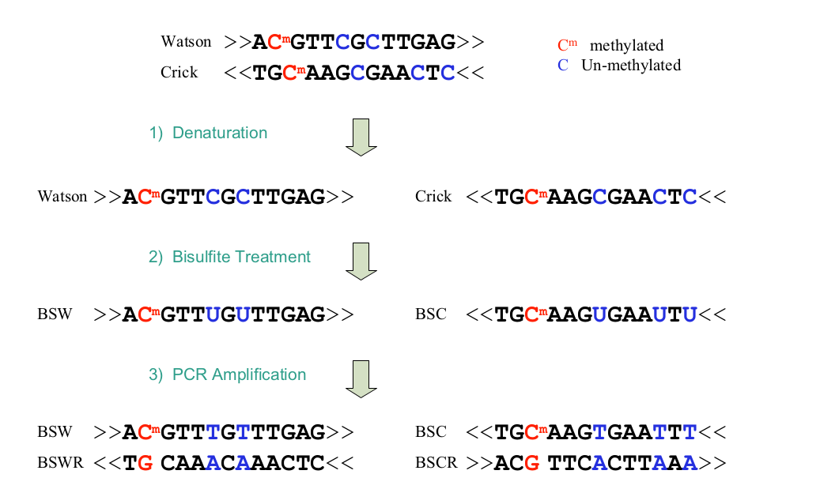
Bisulfite treatment (again)
Xi and Li, BMC Bioinformatics, 2009

Slide 37
3 main strategies for processing WGBS reads
Wild-card alignment
Three-letter alignment
Reference-free processing

Slide 38
Wild-card aligners
Replace Cs in the genomic DNA sequence by the wild‐card letter Y, which matches both Cs and Ts in the read sequence
Or they modify the alignment scoring matrix in such a way that mismatches between Cs in the genomic DNA sequence and Ts in the read sequence are not penalized.
Software: BSMAP, GSNAP, Last/bisulfighter, Pash, RMAP, RRBSMAP and segemehl
Bock, Nat Rev Genet, 2012

Slide 39
Three-base aligner
Simplify bisulphite alignment by converting all Cs into Ts in the reads and for both strands of the genomic DNA sequence
Software: Bismark, BRAT, BS‐Seeker, MethylCoder and GEMBS

Slide 40
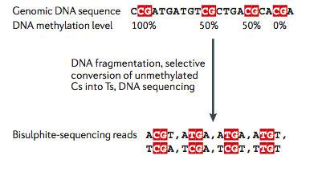
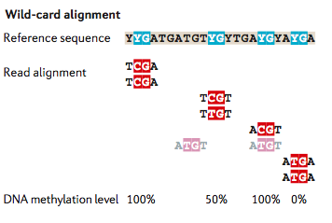
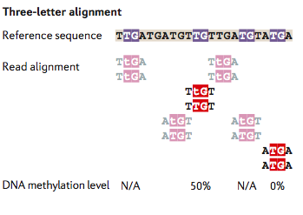
Bisulphite sequence alignment
Bock, Nat Rev Genet, 2012

Slide 41
Strengths and weaknesses
Three‐letter aligners have lower coverage in highly methylated regions because they purge the remaining Cs from the bisulphite‐sequencing reads and thereby decrease their sequence complexity and they become ambiguous.
Wild‐card aligners typically have higher genomic coverage but at the cost of introducing some bias towards increased DNA methylation levels because the extra Cs in a methylated sequencing read can raise the sequence complexity
These problems are more prevalent in repetitive regions of the genome and are reduced with longer reads

Slide 42
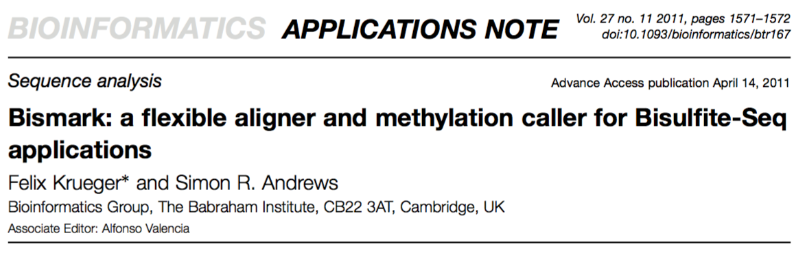
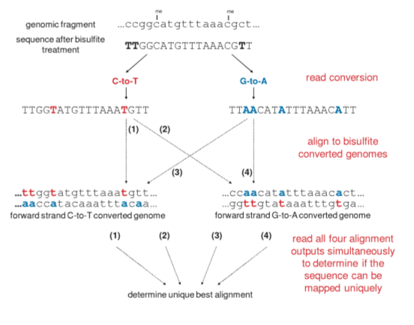
Bismark

Slide 43
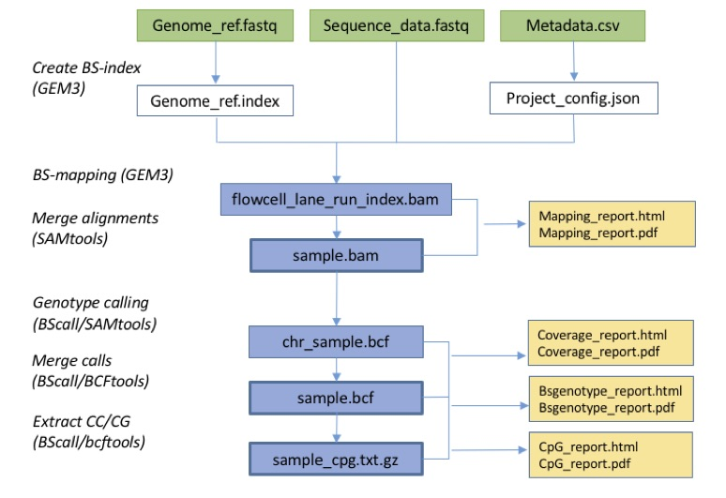
GEMBS
Merkel et al. https://www.biorxiv.org/content/early/2017/10/11/201988

Slide 44
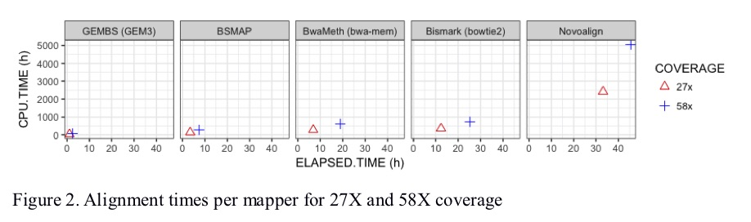
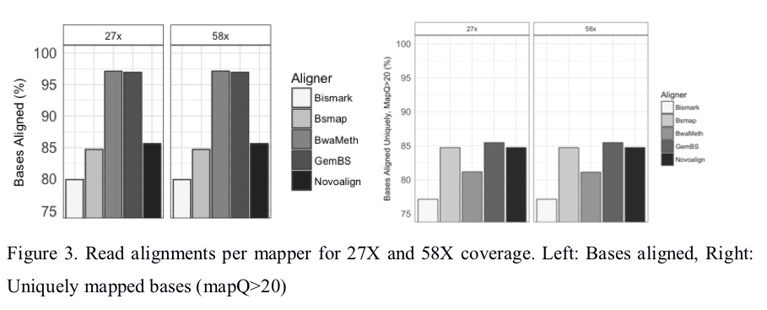
Speed and performance
Merkel et al. https://www.biorxiv.org/content/early/2017/10/11/201988

Slide 45
3 main strategies for processing WGBS reads
Wild-card alignment
Three-letter alignment
Reference-free processing

Slide 46
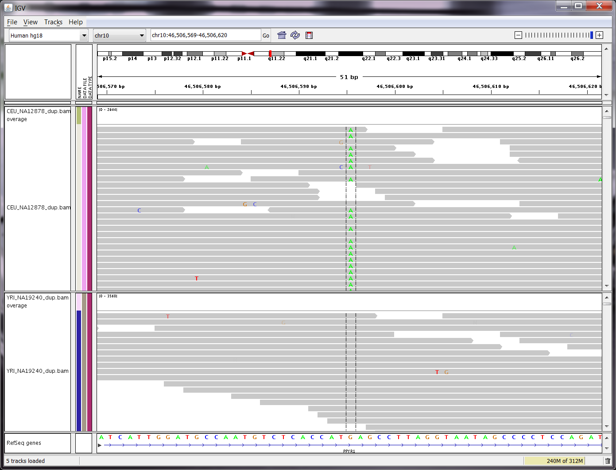
Reference-based variant detection
Michael Stromberg

Slide 47
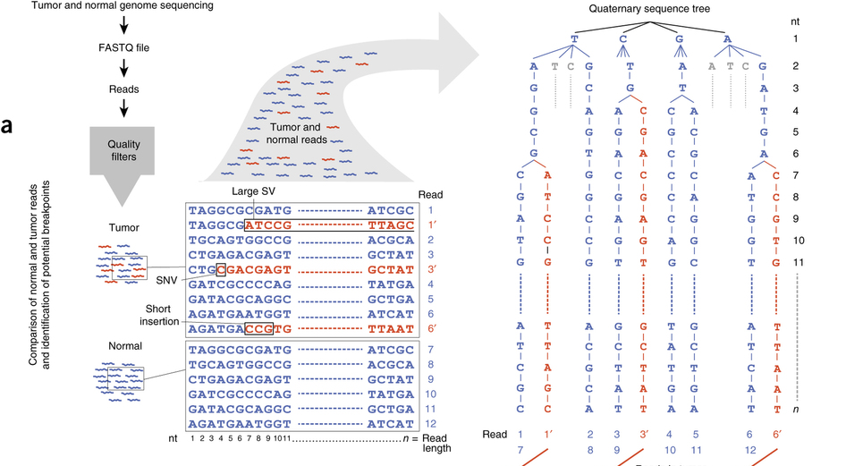
Reference-free variant detection
Moncunill et al. Nature Biotech 2014

Slide 48
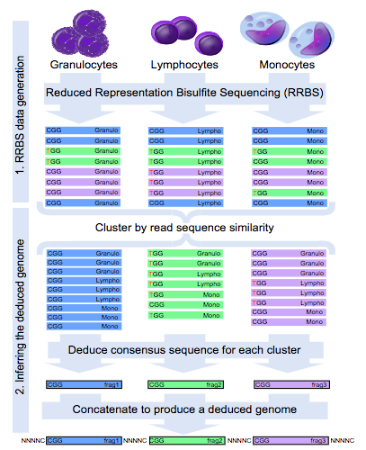
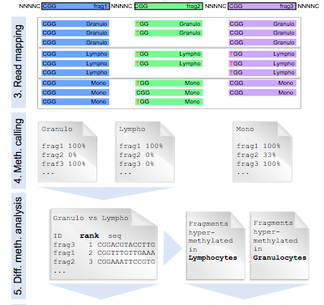
Reference-free methylation analysis
Klughammer et al. Cell Reports 2015

Slide 49
Workflow for analyzing BS-data
Processing of bisulfite-sequencing data:
Quality control and pre-processing
Bisulfite sequence alignment
Quantification of absolute DNA methylation
Data visualization and statistical analysis
Visual inspection in a genome browser of selected regions
Visualization of global distribution of methylation values
Clustering of samples based on similarity
Downstream analysis
Identification of Differentially Methylated Regions (DMRs)
Global analysis of DMRs

Slide 50
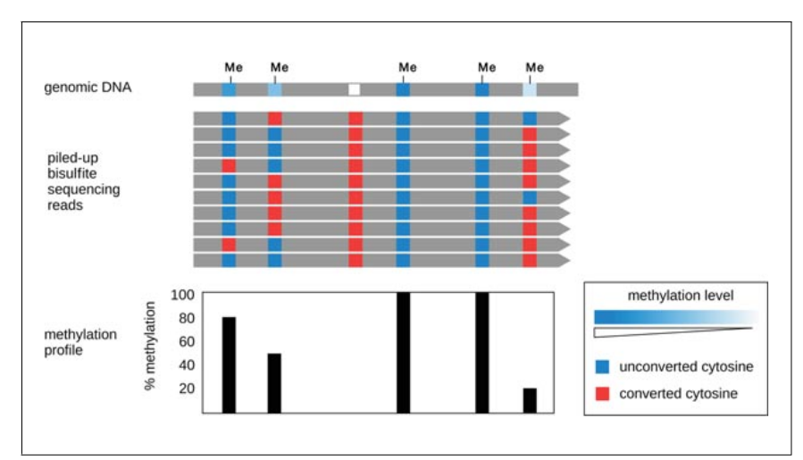
Goal: measure absolute methylation levels
Johnson et al. Curr. Prot. Mol. Bio. 2012

Slide 51
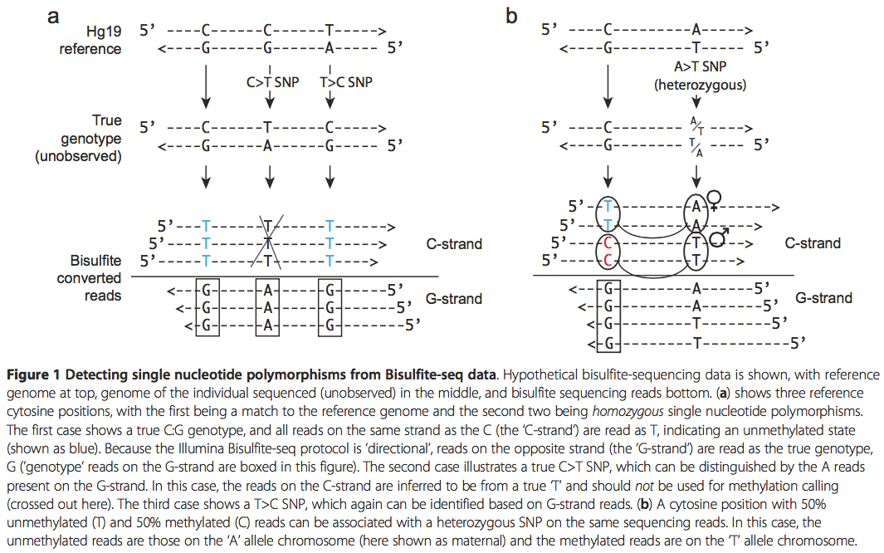
Impact of SNPs
Liu et al. Genome Biol, 2012

Slide 52
BS-seq data SNP/methylation caller
Bis-SNP
MethylExtract
BS-SNPer
BScall
Etc.

Slide 53
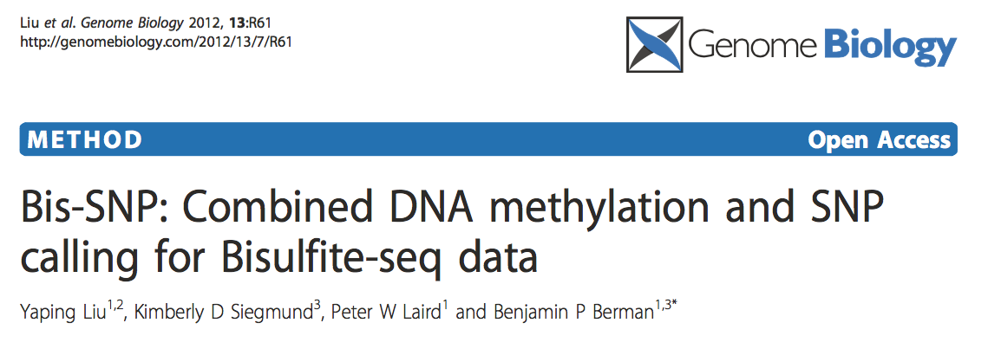
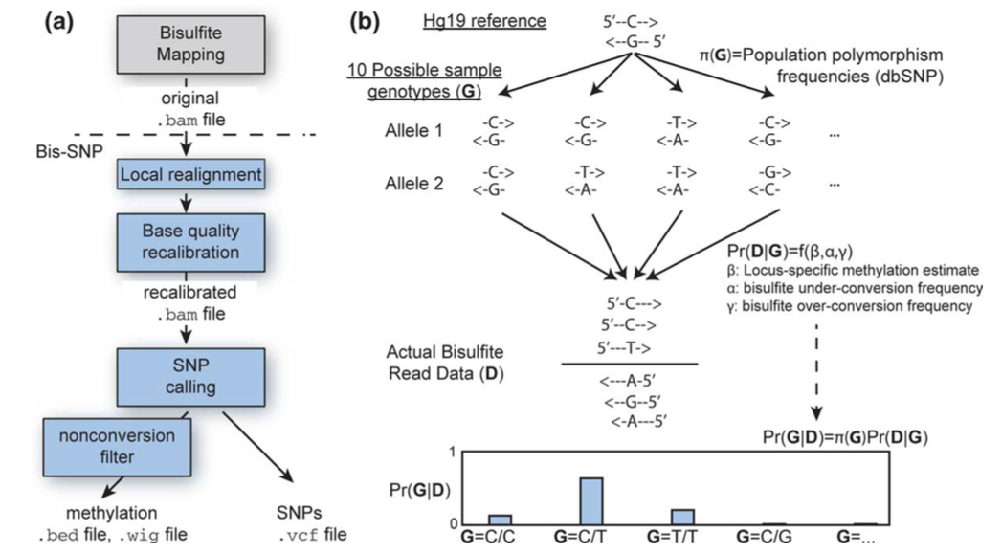
Bis-SNP

Slide 54
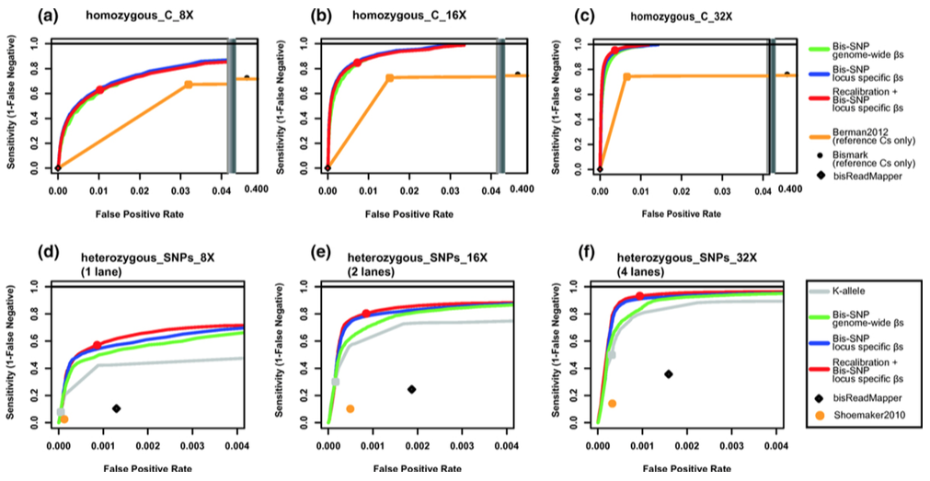
Bis-SNP accuracy
Liu et al. Genome Biol, 2012

Slide 55
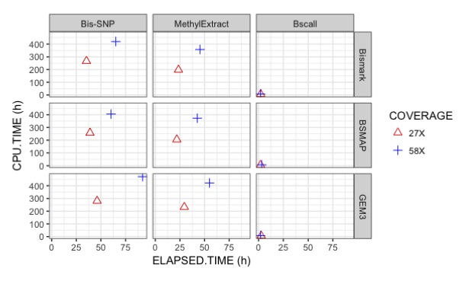
Speed of different SNP callers
Merkel et al. https://www.biorxiv.org/content/early/2017/10/11/201988

Slide 56
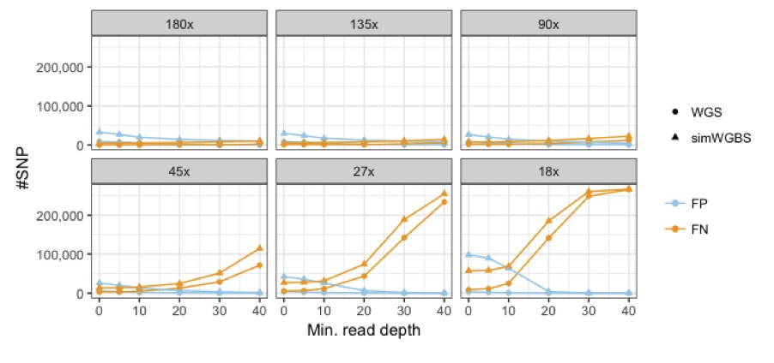
Accuracy of Bscall
Merkel et al. https://www.biorxiv.org/content/early/2017/10/11/201988

Slide 57
Workflow for analyzing BS-data
Processing of bisulfite-sequencing data:
Quality control and pre-processing
Bisulfite sequence alignment
Quantification of absolute DNA methylation
Data visualization and statistical analysis
Visual inspection in a genome browser of selected regions
Visualization of global distribution of methylation values
Clustering of samples based on similarity
Downstream analysis
Identification of Differentially Methylated Regions (DMRs)
Global analysis of DMRs

Slide 58
Visualizing BS-seq data in IGV
Reads are colored by DNA strand. For paired reads, this is the same as coloring by first-of-pair strand.
Gray for forward reads or forward read first pairs (F1 or F1R2)
Sage for reverse reads or reverse read first pairs (R1 or R1F2)
The chosen mode is highlighted in reads with a red or blue nucleotide corresponding to the position of the cytosine in the reference genome.
For forward reads, a red C denotes a nonconverted cytosine, implying methyl or other protection, while a blue T denotes a bisulfite converted cytosine.
For reverse reads, a red G denotes a nonconverted cytosine, implying methyl or other protection, while a blue A denotes a bisulfite converted cytosine.
In zoomed-out views, colored nucleotides are represented by colored lines.

Slide 59
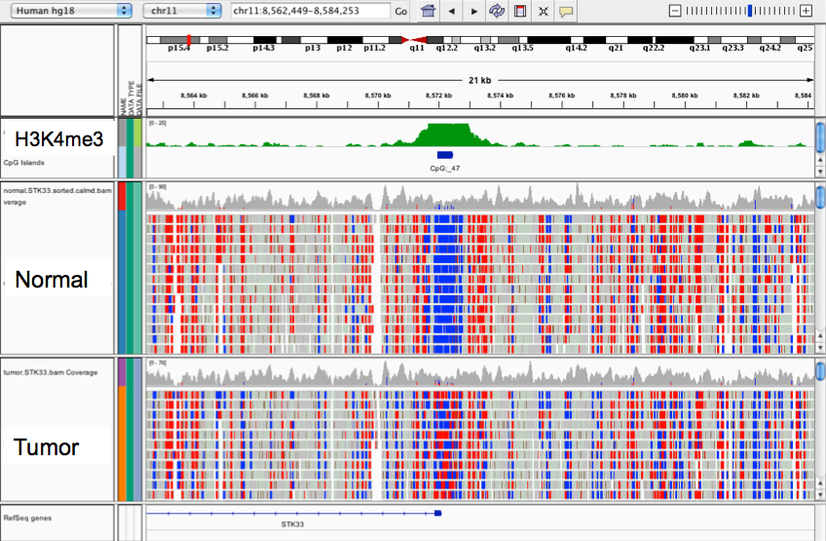
Visualizing BS-seq data in IGV (2)
https://www.broadinstitute.org/igv

Slide 60
Visualizing BS-seq data in IGV (2)
https://www.broadinstitute.org/igv

Slide 61
Workflow for analyzing BS-data
Processing of bisulfite-sequencing data:
Quality control and pre-processing
Bisulfite sequence alignment
Quantification of absolute DNA methylation
Data visualization and statistical analysis
Visual inspection in a genome browser of selected regions
Visualization of global distribution of methylation values
Clustering of samples based on similarity
Downstream analysis
Identification of Differentially Methylated Regions (DMRs)
Global analysis of DMRs

Slide 62
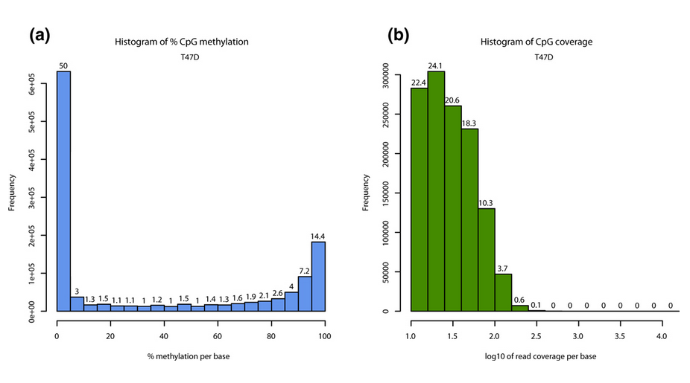
Methylation values
methylKit (Akalin et al. Genome Biol 2012)

Slide 63
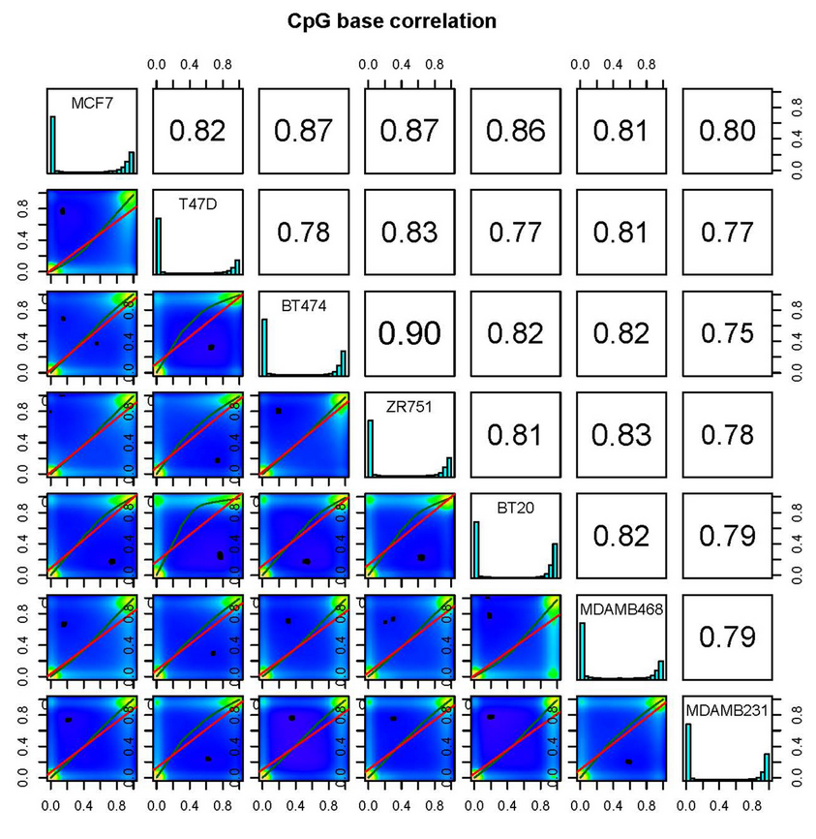
Pairwise correlations
methylKit (Akalin et al. Genome Biol 2012)

Slide 64
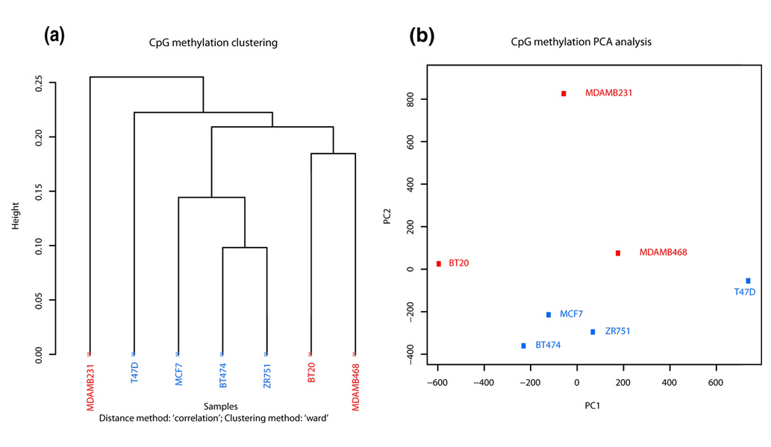
Sample clustering
methylKit (Akalin et al. Genome Biol 2012)

Slide 65
Workflow for analyzing BS-data
Processing of bisulfite-sequencing data:
Quality control and pre-processing
Bisulfite sequence alignment
Quantification of absolute DNA methylation
Data visualization and statistical analysis
Visual inspection in a genome browser of selected regions
Visualization of global distribution of methylation values
Clustering of samples based on similarity
Downstream analysis
Identification of Differentially Methylated Regions (DMRs)
Global analysis of DMRs

Slide 66
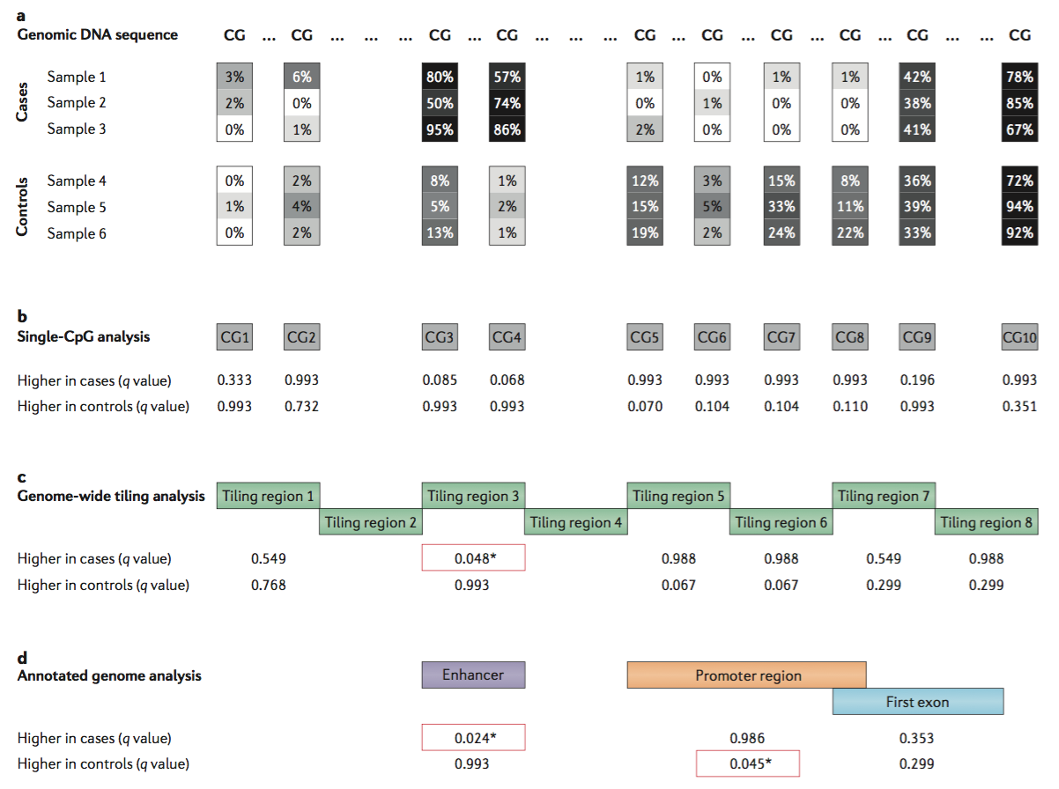
Differentially methylated regions

Slide 67
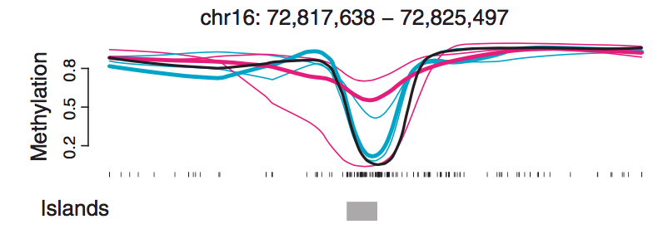
Need for biological replicates
Hansen et al. Genome Biol 2012

Slide 68
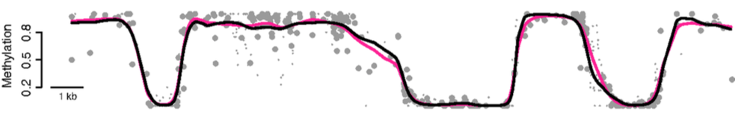
Advantages of smoothing
BSmooth (Hansen et al. Genome Biol 2012)

Slide 69
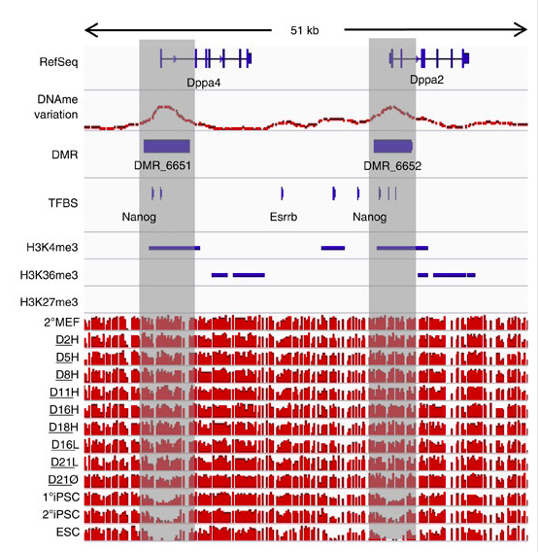
DMRs example
Lee et al. Nat. Commun. 2014

Slide 70
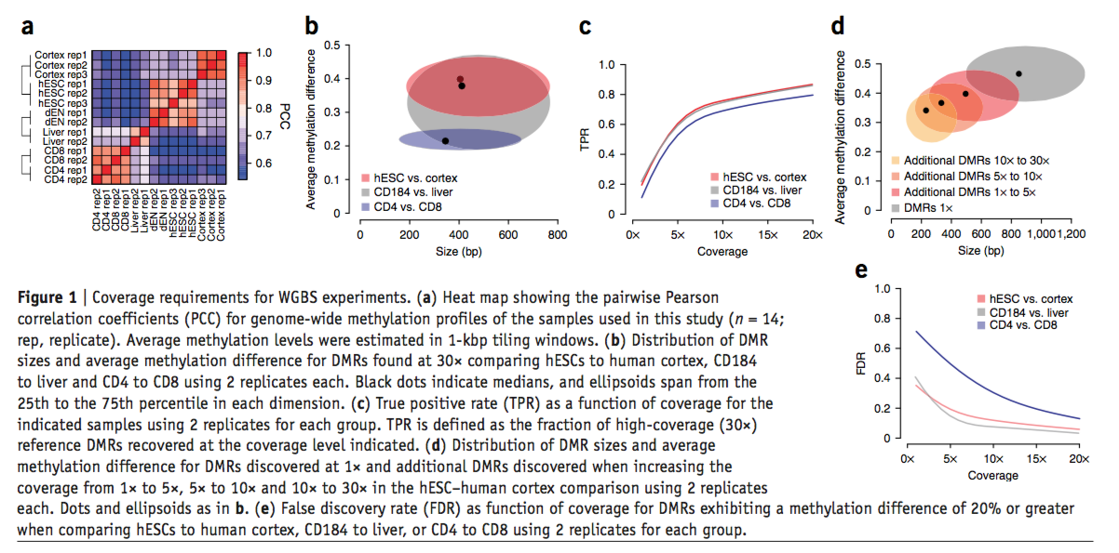
Coverage requirements
Ziller et al. Nat Methods 2015

Slide 71
Conclusions
BS-seq analysis is not easy
Need to choose the appropriate DNA methylation technology
Need to check quality and watch for biases
Need to perform a multiple-step analysis workflow
That’s what we’ll do in the lab!

Slide 72
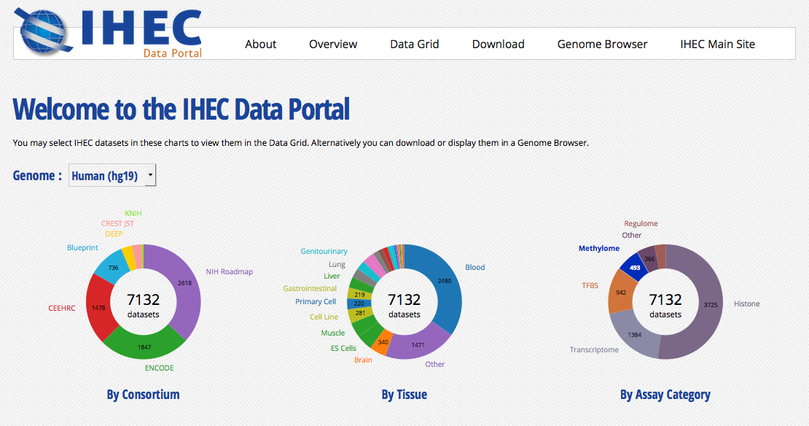
Available WGBS datasets

Slide 73
We are on a Coffee Break & Networking Session

